Slide 1
FD | Nuevos |  | Antiguos
 | 40% | 80% | 40% | 80%
Jan | 3.6 | 8.1 | 3.6 | 7.4
Feb | 3.7 | 9.7 | 4.4 | 7.9
Mar | 3.4 | 9.8 | 3.4 | 10.6
Apr | 2.3 | 6.4 | 2.8 | 7.3
May | 4.1 | 7.8 | 3.6 | 8.4
Jun | 3.7 | 9.6 | 3.9 | 7.8
Jul | 4.8 | 11.4 | 5.2 | 11.3
Aug | 5.5 | 11.2 | 6.6 | 9.8
Sep | 3.8 | 9.7 | 4.6 | 10.2
Oct | 2.4 | 7.9 | 3.4 | 8.8
Nov | 3.9 | 8.1 | 4.4 | 9.3
Dec | 4.2 | 8.7 | 3.6 | 10.5
IGS | Nuevos |  | Antiguos
 | 40% | 80% | 40% | 80%
Jan | 0.4 | 0.8 | 0.4 | 0.8
Feb | 0.4 | 1.1 | 0.5 | 1
Mar | 0.5 | 1.2 | 0.6 | 1.1
Apr | 0.4 | 1 | 0.4 | 0.8
May | 0.4 | 1.1 | 0.3 | 0.9
Jun | 0.4 | 1 | 0.5 | 1
Jul | 0.4 | 1.2 | 0.4 | 1
Aug | 0.4 | 1 | 0.4 | 1
Sep | 0.3 | 0.6 | 0.2 | 0.5
Oct | 0.2 | 0.6 | 0.2 | 0.6
Nov | 0.3 | 0.6 | 0.3 | 0.7
Dec | 0.4 | 0.8 | 0.4 | 1

Slide 2
1992-2020
1995-2017
2012-2020
FD | Nuevos |  | Antiguos |  | 2012-2020
 | 40% | 80% | 40% | 80% | 40% | 80%
Jan | 3.6 | 8.1 | 3.6 | 7.4 | 4.7 | 7.6
Feb | 3.7 | 9.7 | 4.4 | 7.9 | 3.6 | 9.3
Mar | 3.4 | 9.8 | 3.4 | 10.6 | 1.9 | 10.1
Apr | 2.3 | 6.4 | 2.8 | 7.3 | 2.5 | 5.4
May | 4.1 | 7.8 | 3.6 | 8.4 | 0.7 | 4.3
Jun | 3.7 | 9.6 | 3.9 | 7.8 | 4 | 6
Jul | 4.8 | 11.4 | 5.2 | 11.3 | 4 | 8.4
Aug | 5.5 | 11.2 | 6.6 | 9.8 | 3.2 | 7.2
Sep | 3.8 | 9.7 | 4.6 | 10.2 | 1.6 | 7.8
Oct | 2.4 | 7.9 | 3.4 | 8.8 | 1.2 | 4.6
Nov | 3.9 | 8.1 | 4.4 | 9.3 | 3.9 | 9.1
Dec | 4.2 | 8.7 | 3.6 | 10.5 | 2.7 | 4.5

Slide 3
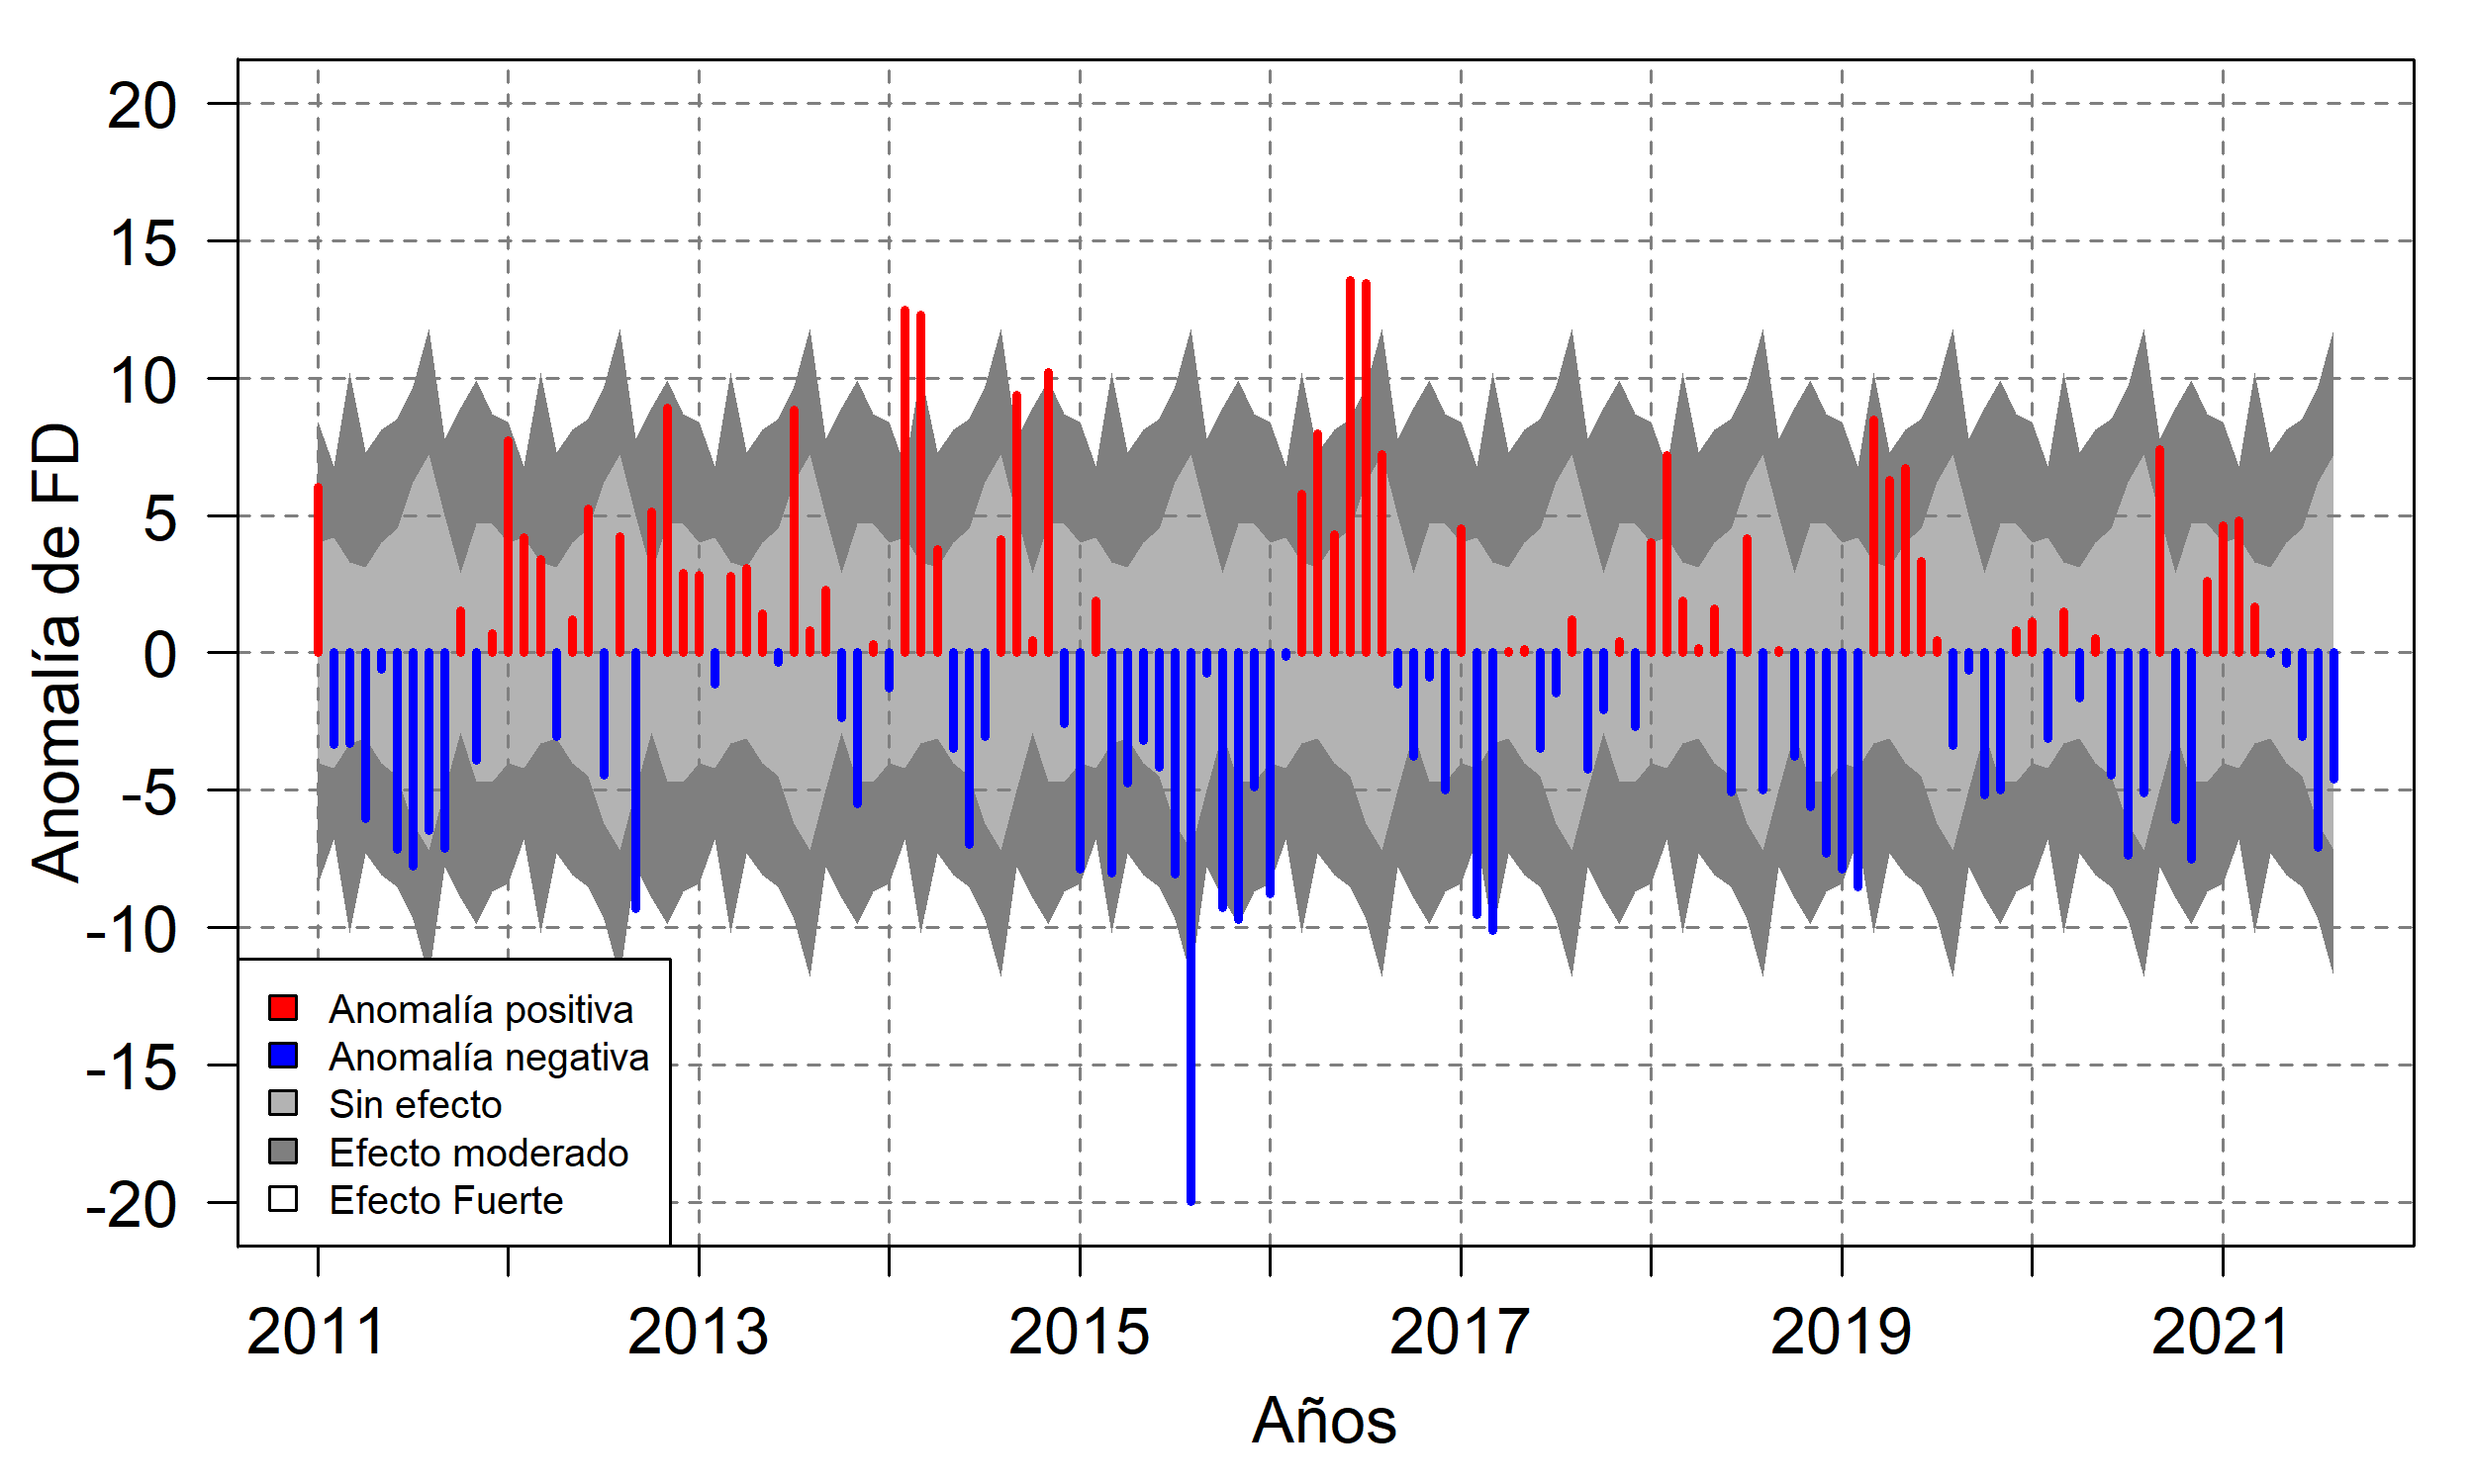
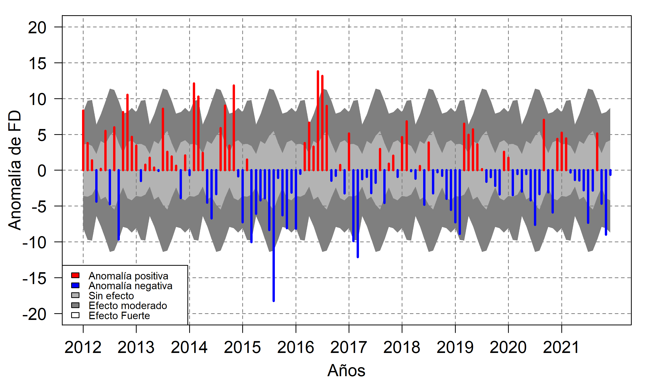

Slide 4
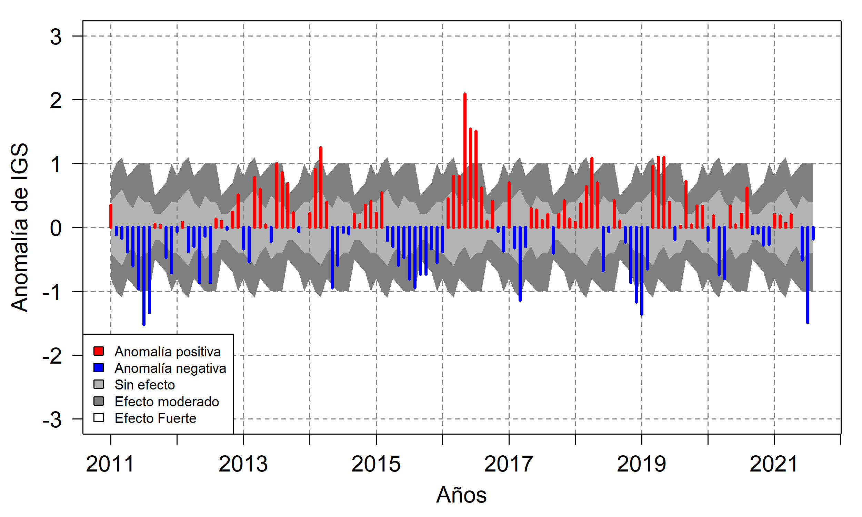
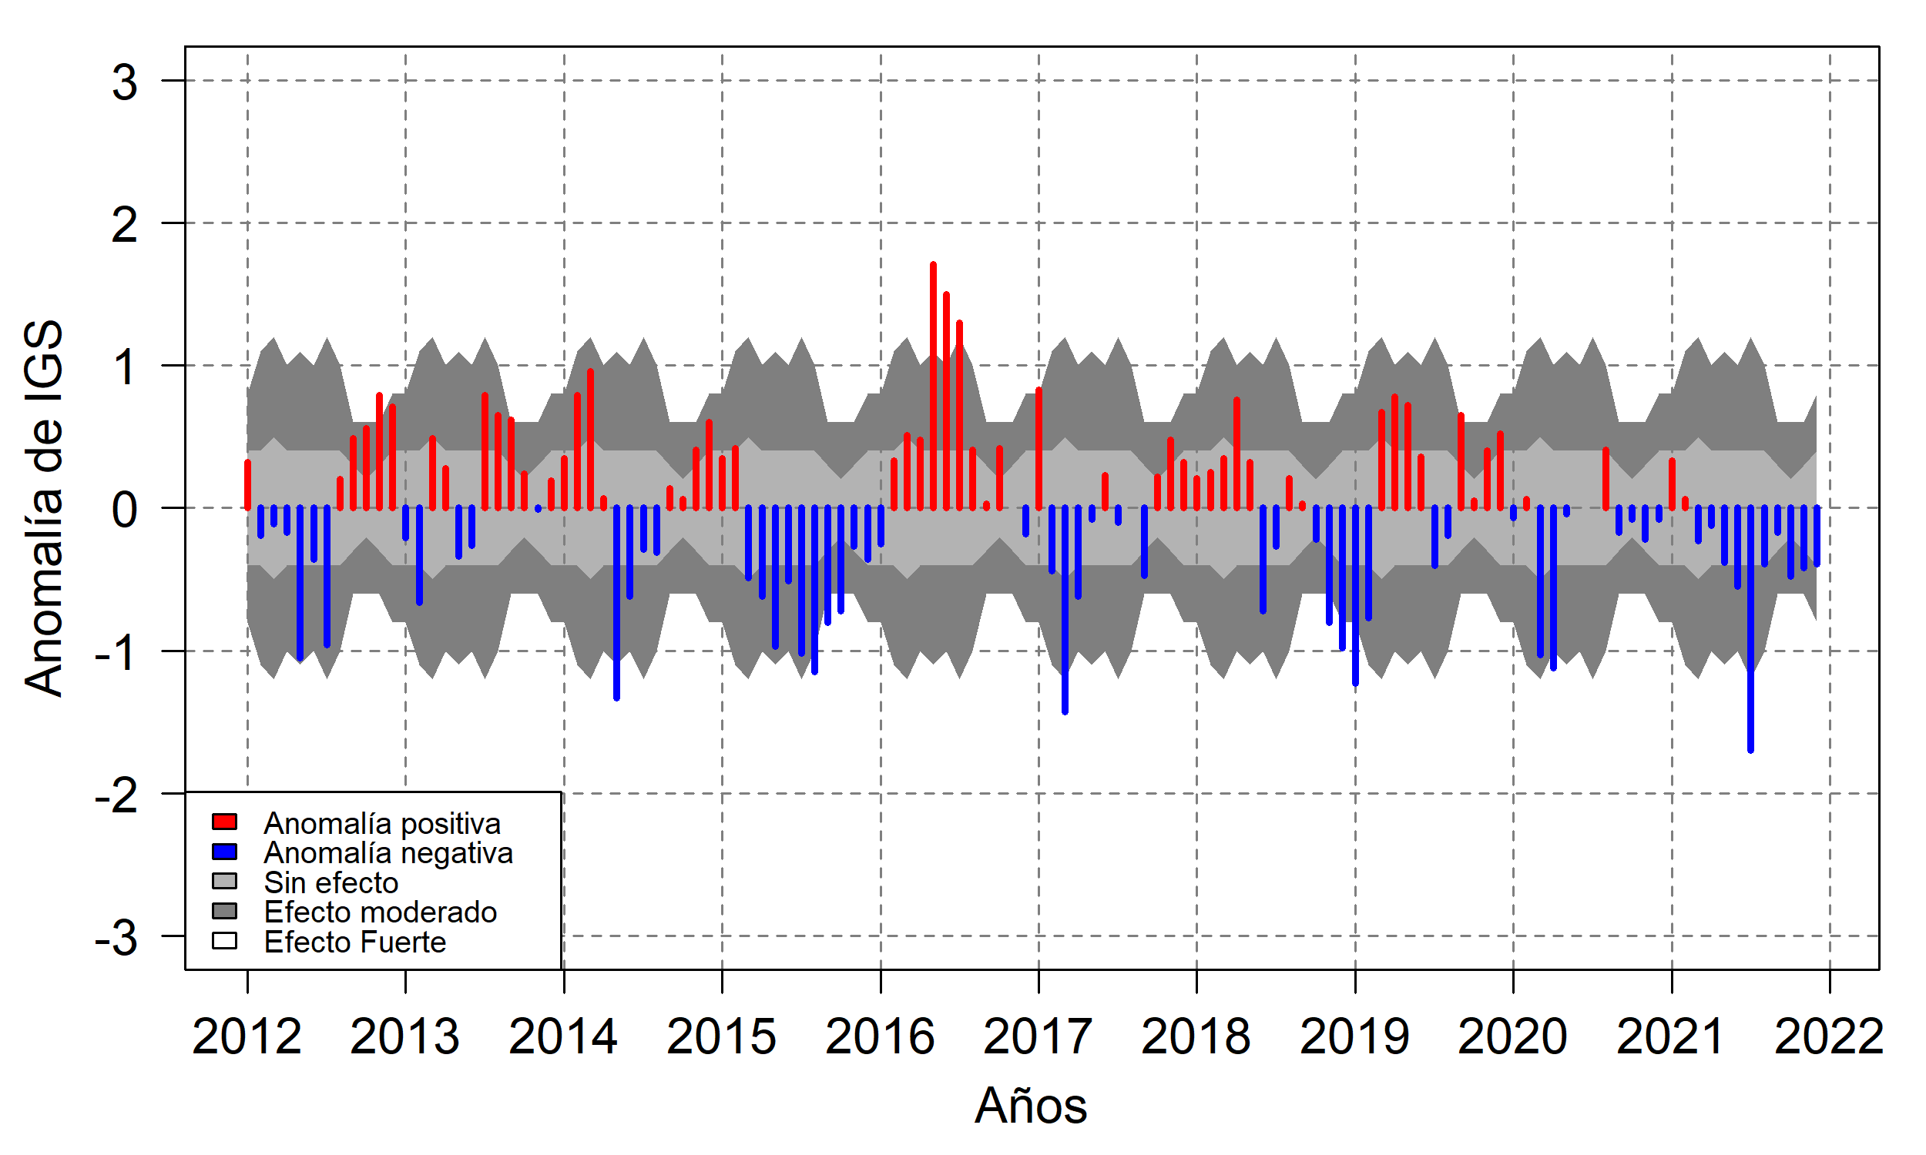

Slide 5
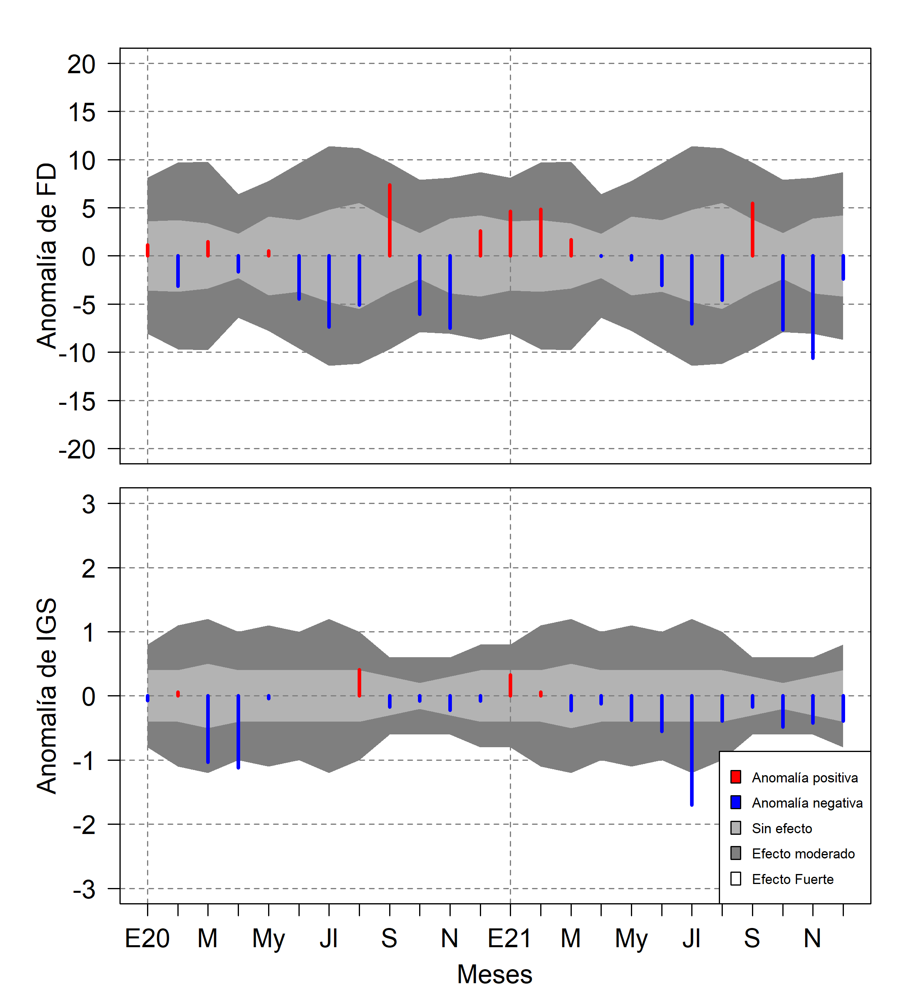
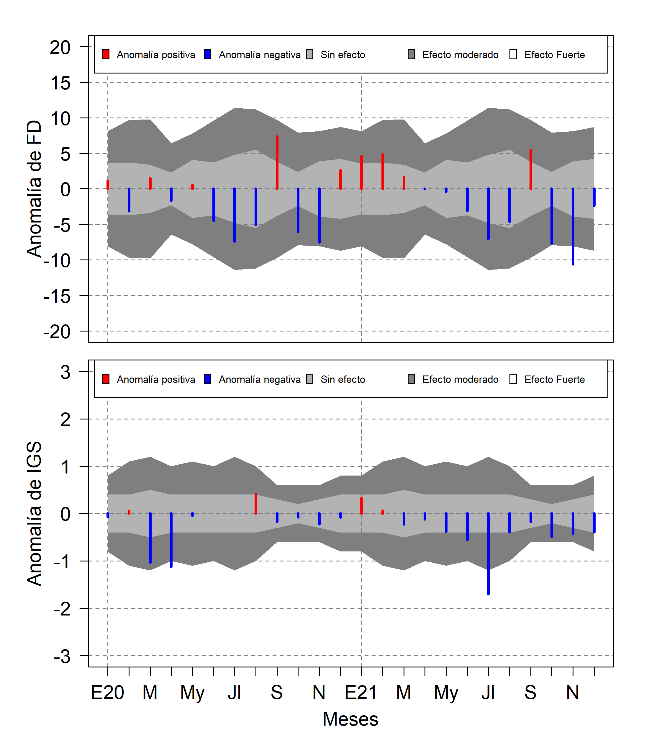

Slide 6
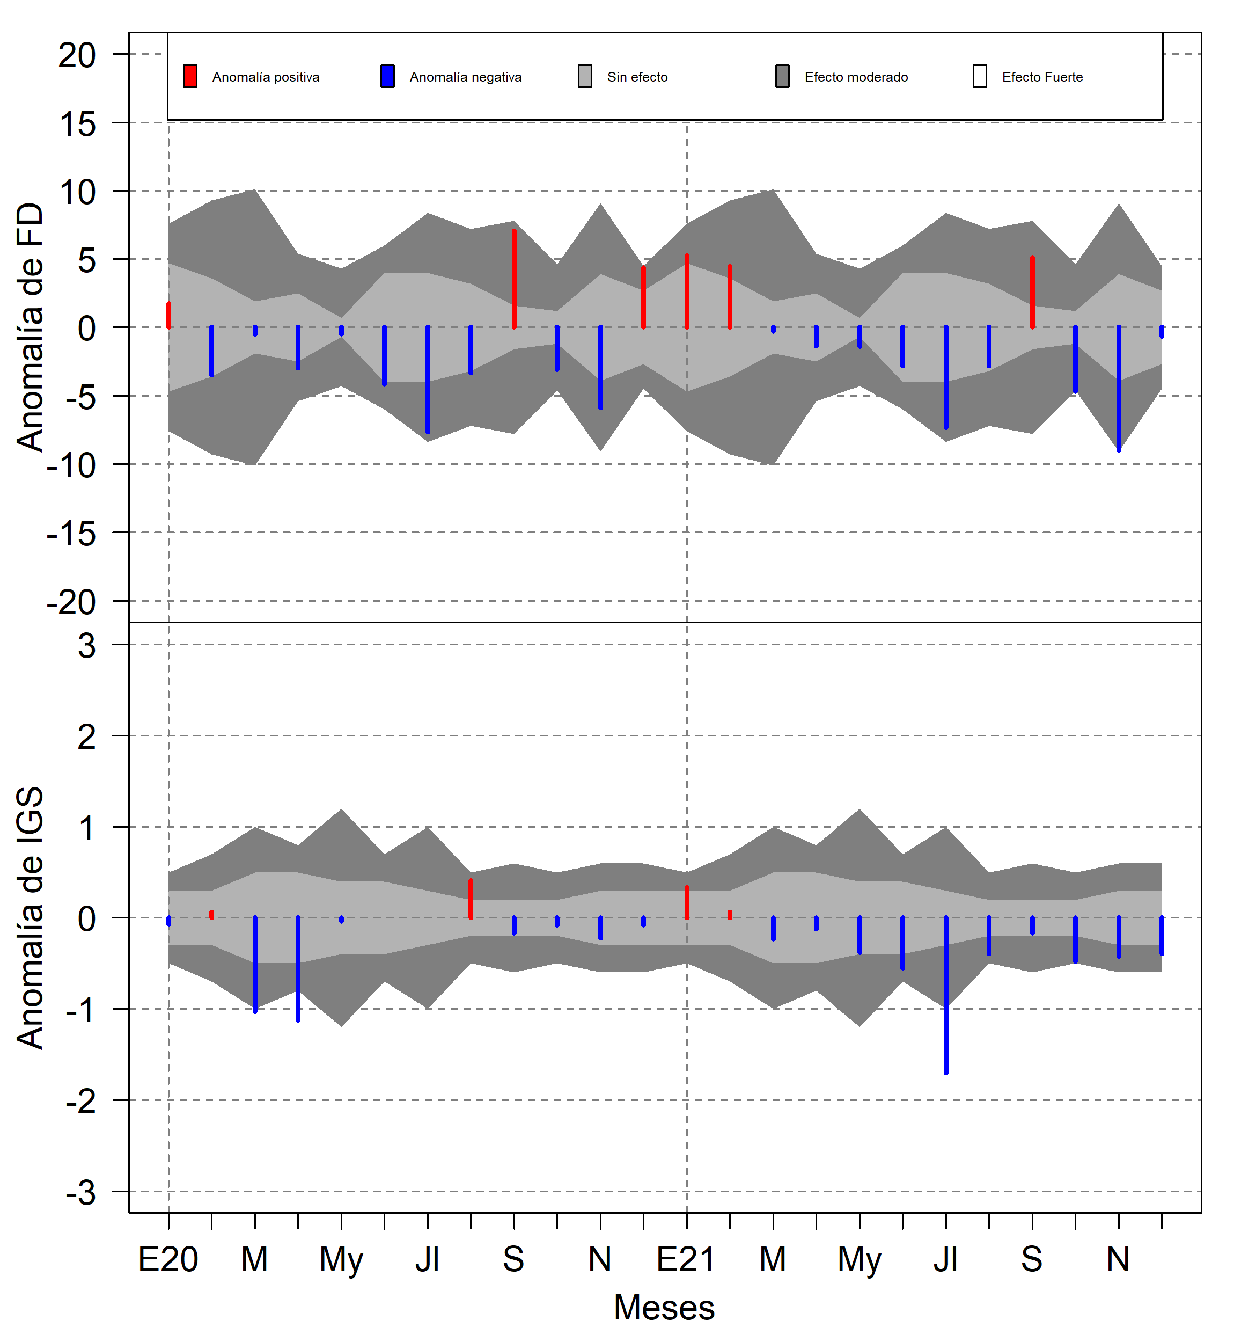
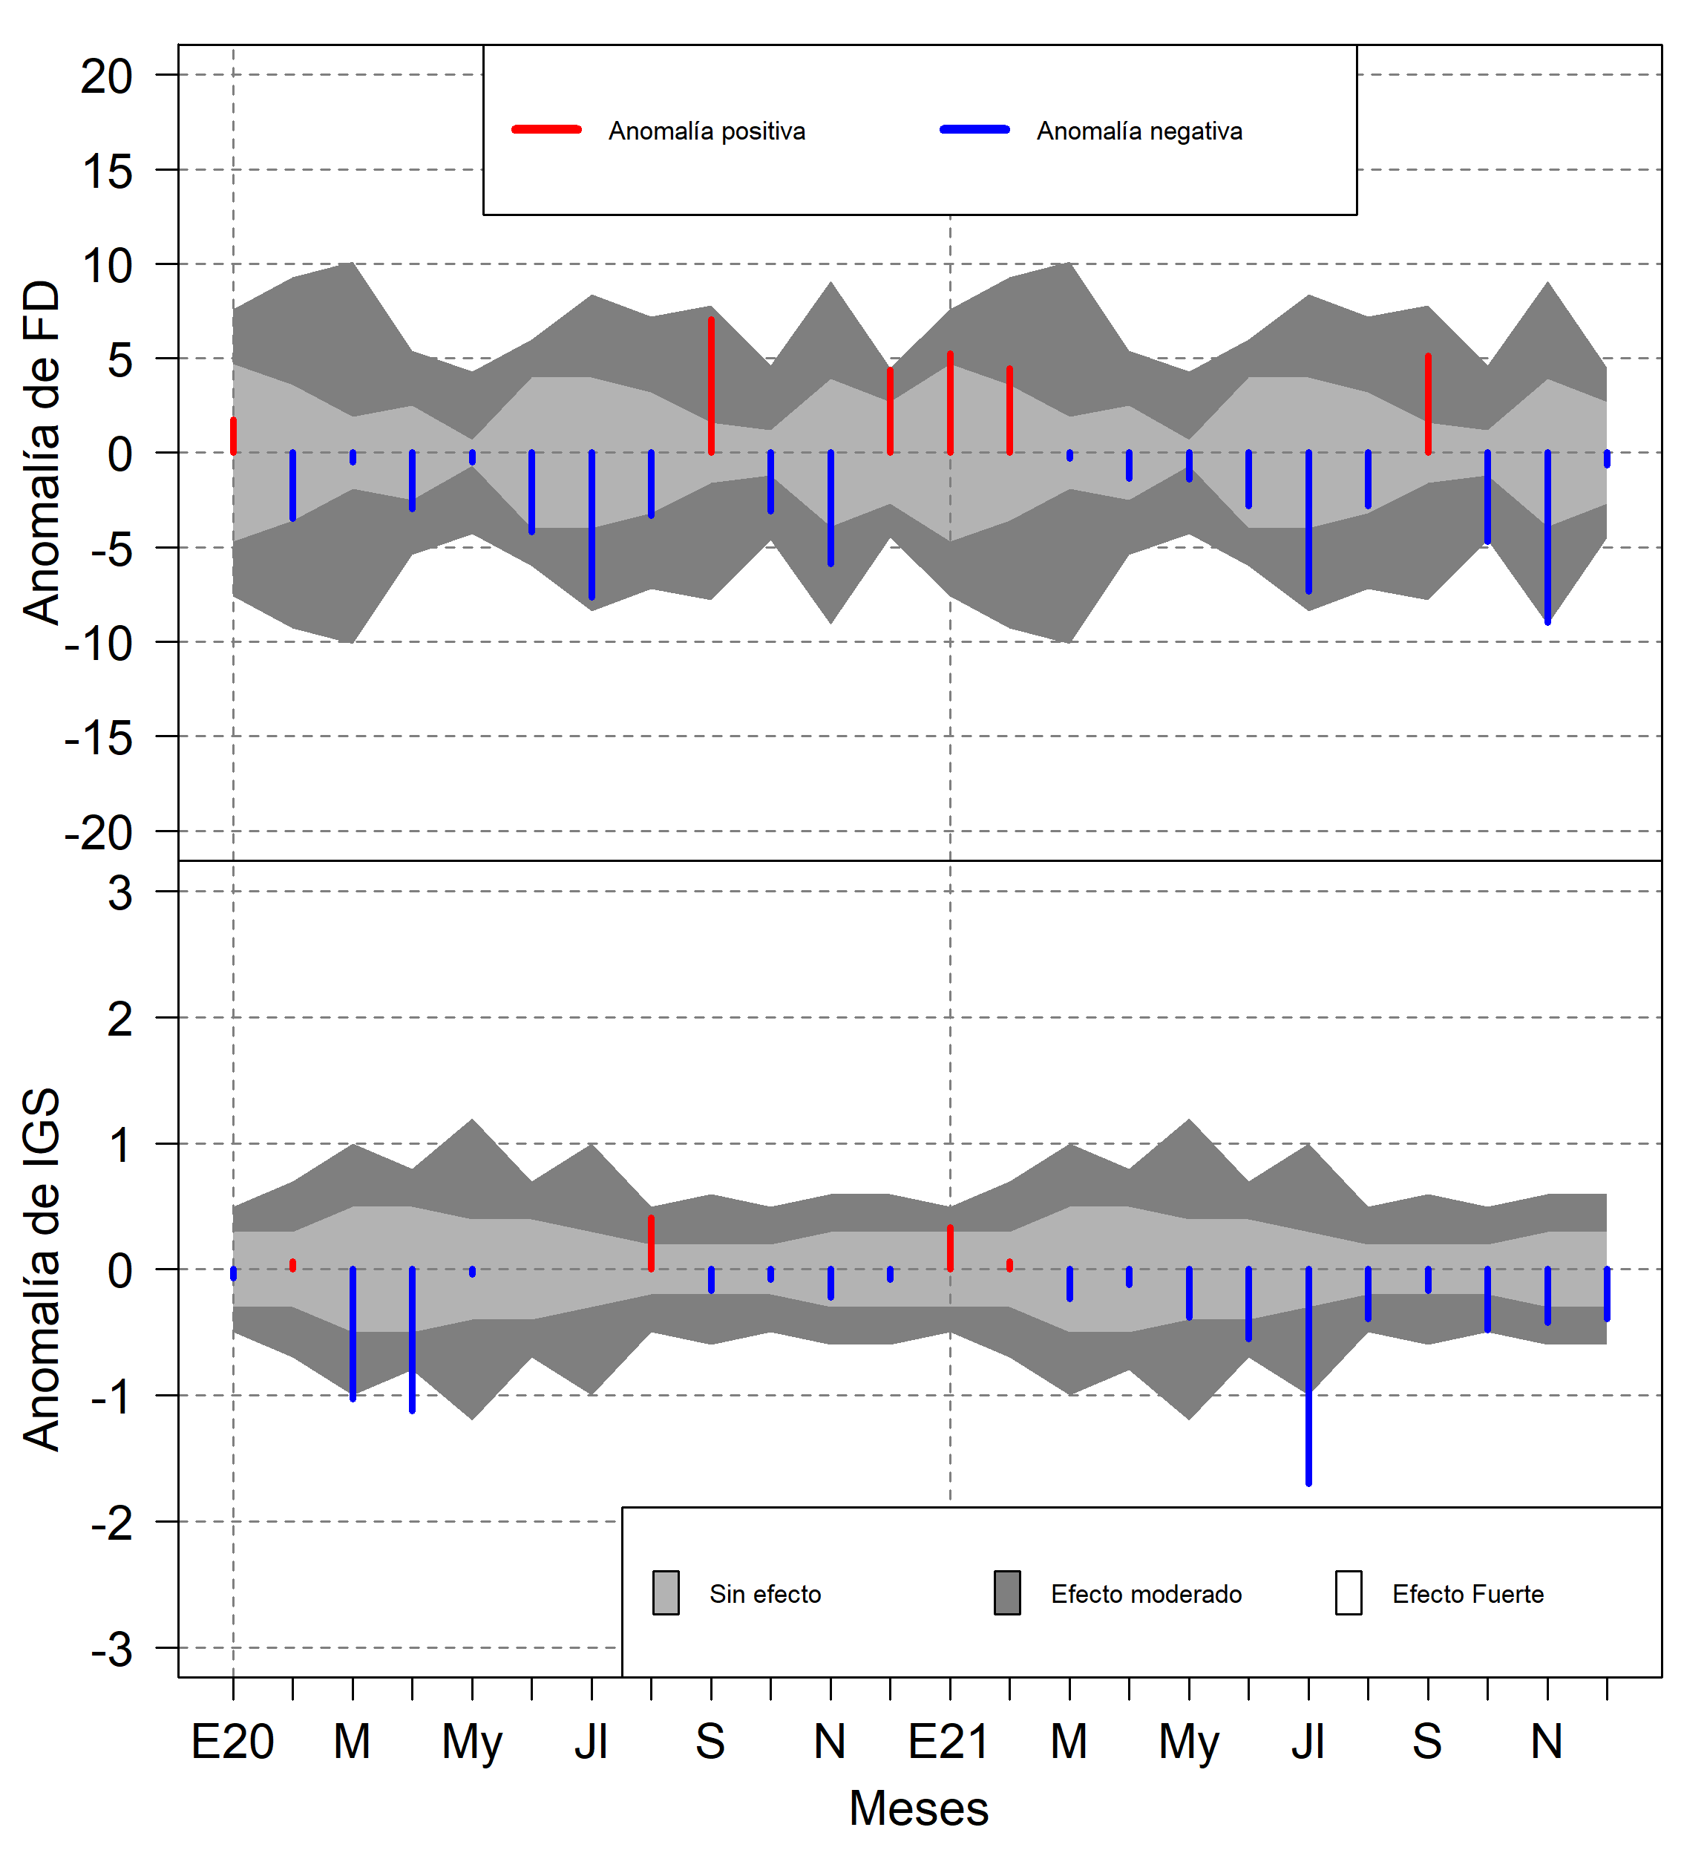

Slide 7
